Slide 1


AIS PRESENTATION TO
HUBBARD COLA
OCTOBER 31, 2013
Ken Grob/Jeff Bjorkman
AIS PREVENTION STRATEGY/KEY MESSAGE
ECONOMIC IMPACTS-WATERSHEDS & TMV
ZEBRA MUSSEL VELIGER LIFE CYCLES
WHY IS WATERCRAFT INSPECTION CRITICAL?
WATERCRAFT INSPECTION REPORT 2013
2014 PROGRAM
Partnering to Protect Our Lakes

Slide 2
DNR STATE-WIDE AIS ADVISORY COMMITTEE
COMMITTEE APPOINTED IN JANUARY 2013; 15 MEMBERS AND 4 EX-OFFICIO MEMBERS; PLUS DNR TEAM
  KEN GROB (COLA/COUNTY) AND MATT DOTTA (AMC) COMMITTEE MEMBERS
ORGANIZATION/PRIORTY SETTING/LEADERSHIP-SPRING
  STRONG SUPPORT FOR LGU FUNDING
  LETTERS TO GOVERNOR AND DNR COMMISSIONER SUPPORTING LEGISLATION
BREAK WITH FIELD TRIP --SUMMER
CURRENT FOCUS
  PREPARING ANNUAL REPORT/ DNR ROUNDTABLE IN JANUARY
  COMMUNICATIONS SUB-COMMITTEE
  LEGISLATION SUB-COMMITTEE
  AIS SUSTAINABLE FUNDING SUB-COMMITTEE
WEBSITE --AGENDAS/MINUTES: www.dnr.state.mn.us/aisadvisory/index.html

Slide 3
AIS PREVENTION STRATEGY
DNR STATE-WIDE STRATEGY ELEMENTS
PUBLIC AWARENESS & EDUCATION
PREVENTION
  (Watercraft inspections, LSP and Bait Dealer Laws, etc.)
EARLY DETECTION
  (Veliger testing and vegetation checks)
RAPID RESPONSE
CONTAINMENT
MITIGATION/MANAGEMENT
  (CLPW on Portage & 11th CW)
LAW ENFORCEMENT
ADMINISTRATION
FRAMEWORK FOR HUBBARD COLA AND AIS TASK FORCE

Slide 4
CONSISTENT MESSAGE
FOR TOWNSHIPS
AND LAKE ASSOCIATIONS
AIS (ZEBRA MUSSEL) MAJOR EXPANSION SINCE 2000 IN MN
WATERCRAFT MOVEMENT FROM SUPER SPREADER LAKES ARE MAIN SOURCE OF NEW AIS INFESTATIONS
PREVENTION IS THE MOST COST EFFECTIVE ACTION
WATERSHEDS MUST BE PROTECTED--ZM VELIGERS
IMPACTS ARE ECONOMIC, FISHING, RECREATIONAL, AND ECOLOGICAL
EVERYONE IS AFFECTED; EVERYONE RESPONSIBLE FOR PREVENTION
DNR CAN’T STOP SPREAD ALONE--LAWS, POLICIES, MANPOWER CAN’T DO IT ALL.
DNR FOCUS IS ON CONTAINMENT & ENABLING LOCAL ORGANIZATIONS AND GOVERNMENT TO SHIELD UNINFESTED LAKES
WATERCRAFT INSPECTIONS ARE A VITAL ELEMENT OF PREVENTION--NO ONE DOES IT BETTER THAN HUBBARD CO.
THERE IS HOPE--MN SLOWING SPREAD, RESEARCH, LSP’s, RESORTS, LAW ENFORCEMENT, PUBLIC AWARENESS….PUBLIC DEMAND FOR ACTION FROM STATE AND LOCAL GOVERNMENT

Slide 5
MAJOR HUBBARD COUNTY WATERSHEDS
LONG LAKE - Henrietta & Hubbard Twp’s
KABEKONA AND PLANTAGENET - Rockwood, Helga, Lakeport Twp’s
CROW WING RIVER CHAIN
  11TH CW TO 1ST CW LAKES AND RIVER – City of Akeley; Akeley, Nevis, CW Lake Twp’s
MANTRAP CHAIN
  BIG MANTRAP LAKE- Clay, Thorp, Lake Emma, Mantrap Twp’s
  UPPER & LOWER BOTTLE LAKES – Lake Emma Twp
  LAKE EMMA – Lake Emma Twp
  BIG SAND LAKE – Lake Emma Twp
  LITTLE SAND LAKE – Lake Emma Twp
  DEER/SHALLOW LAKE – Nevis Twp
  BELLE TAINE LAKE – Nevis Twp; City of Nevis
FISH HOOK RIVER CHAIN
  ISLAND LAKE/EAGLE LAKE – Arago Twp
  POTATO LAKE – Arago/Lake Emma Twp’s
  BLUE LAKE – Lake Emma Twp
  PORTAGE LAKE – Todd Twp
  FISH HOOK LAKE/RIVER – Todd Twp; City of Park Rapids
AIS Spreads Quickly Throughout a Watershed

Slide 6
HUBBARD COUNTY FACTS
OUR CLEAN LAKES ARE A MAJOR RESOURCE
MANY DESTINATION LAKES; EXCELLENT WATER QUALITY
ECONOMIC, RECREATIONAL, SWIMMING, AND FISHING
RESORTS/CAMPGROUNDS DEPEND ON CLEAN LAKES
FISHING TOURNAMENTS & WATER-RELATED EVENTS
TAX ENTITY (Township) | 2011 TMV (Water Related) | % of Total TMV | 2011 Net Taxes (Water Related) | Note
Lake Emma | $357,011,600 | 87.5% | $2,668,795 | ---
Nevis | $209,118,300 | 78.2% | $1,401,933 | ---
Hubbard | $170,000,700 | 69.7% | $1,204,173 | ---
Henrietta | $150,459,100 | 57.1% | $1,114,173 | ---
Mantrap | $145,453,200 | 80.4% | $900,566 | ---
Arago | $139,303,900 | 74.5% | $1,006,127 | ---
Crow Wing Lake | $127,133,800 | 84.6% | $691,316 | ---
Lake Property Drives Majority of Tax Base

Slide 7
EXAMPLES OF ECONOMIC IMPACT
*WISCONSIN STUDY INDICATED A 13% REDUCTION OF PROPERTY VALUES WITH THE INFESTATION OF EURASIAN WATER MILFOIL (ZEBRA MUSSELS WILL BE MORE)
WATERSHED (CY2011) | TMV BASE TOT. NET TAXES | 10% TMV LOSS TAX LOSS | 13%* TMV LOSS TAX LOSS | 30% TMV LOSS TAX LOSS
LONG LAKE (Henrietta & Hubbard Twp) | $211MM $1,578K | $21.1MM $157.8K | $27.4MM $205K | $63.3MM $473.4K
MANTRAP CHAIN OF LAKES (Mantrap, Big Sand, Lt Sand, Belle Taine Lakes) | $367MM $2,689K | $36.7MM $268.9K | $47.7MM $349.6K | $110.1MM $806.7K
FISH HOOK & POTATO LAKE (Arago/Lk EmmaTwp) ** Includes F.H. River | $174MM $1,621K** | $17.4MM $162.1K** | $22.6MM $210.7K** | $52.2MM $486.3K**
PLANTAGENET (Rockwood & Helga Twp) | $43.7MM $349K | $4.4MM $34.9K | $5.7MM $45.4K | $13.2MM $104.7K
KABEKONA (Lakeport Twp) | $100MM $905K | $10MM $90.5K | $13MM $117.7K | $30MM $271.5K
County Infestation would likely cause a Significant Tax Revenue Gap

Slide 8
WHY DO WATERCRAFT INSPECTION?
EDUCATE -- CHANGE BEHAVIORS PREVENT INTRODUCTION
 | Qualifying questions to ask arriving watercraft owners
 | 1. Are the drain plugs removed?
 | 2. Has water been drained and wiped out?
 | 3. What was the last lake the boat was on? 4. Has water been drained from the motor?
 |  | If last in infested waters go through flow chart… Decontaminate watercraft if necessary
 |  | Good practice to treat all boats like they are coming from infested waters
Watercraft arrives from infested waters
Are invasives visually present on watercraft?

Slide 9
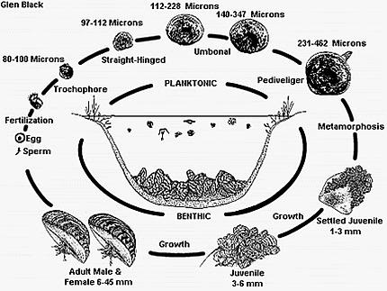

Slide 10
GENERAL FACTS ABOUT VELIGERS
ADULT ZEBRA MUSSELS SPAWN ABOVE 54 DEGREES
VELIGERS ARE FRAGILE AND HAVE A HIGH MORTALITY
VELIGERS ‘PRECIPITATE’ OUT IN 4-6 WEEKS-HARD SURFACE
DNR SURVEY FOUND “NO VELIGERS” IN WINTER*
DNR SURVEY SHOWED June-Sept AS HIGH RISK MONTHS*
DNR SURVEY INDICATED VERY LOW NUMBERS OF VELIGERS IN RESIDUAL BOAT WATER (Outboard motors)*
* Survey done on highly infested MN lakes
IT IS A RISK MANAGEMENT GAME
CLEAN, DRAIN, DISPOSE (IT IS THE LAW)
RINSE & DRY (IT IS RECOMMENDED)
DECONTAMINATE (IT IS THE LAW/RECOMMENDED)

Slide 11
To those that say it is not if but when, this is what WHEN looks like!
My children and grandchildren have gotten cut feet and legs attempting to use the shoreline
If we want to go for a swim, we now get in the boat and go out to deep water
We can no longer use lake irrigation: back to dragging around hoses from well source
The clearing of the water due to plankton filtering has caused the sun to go deeper creating an algae mess on the lake
My property values have shrunk….I guess I don’t know what they are now because nothing sells on the lake
We need to clean our beach, dock area and boat motor regularly….so that the boat will run and to reduce the stench
Where are the walleye?
Everyone is asking: “Why didn’t someone do something to prevent this from happening?”
Increased political dialogue, funding for inspection, enforcement, research, more stringent laws and penalties, all point to the potential that “when” can be avoided
Notes:
The future may judge us to be naïve as to our ability to prevent this threat; How can we with what we know today, adopt a defeatist attitude?

Slide 12
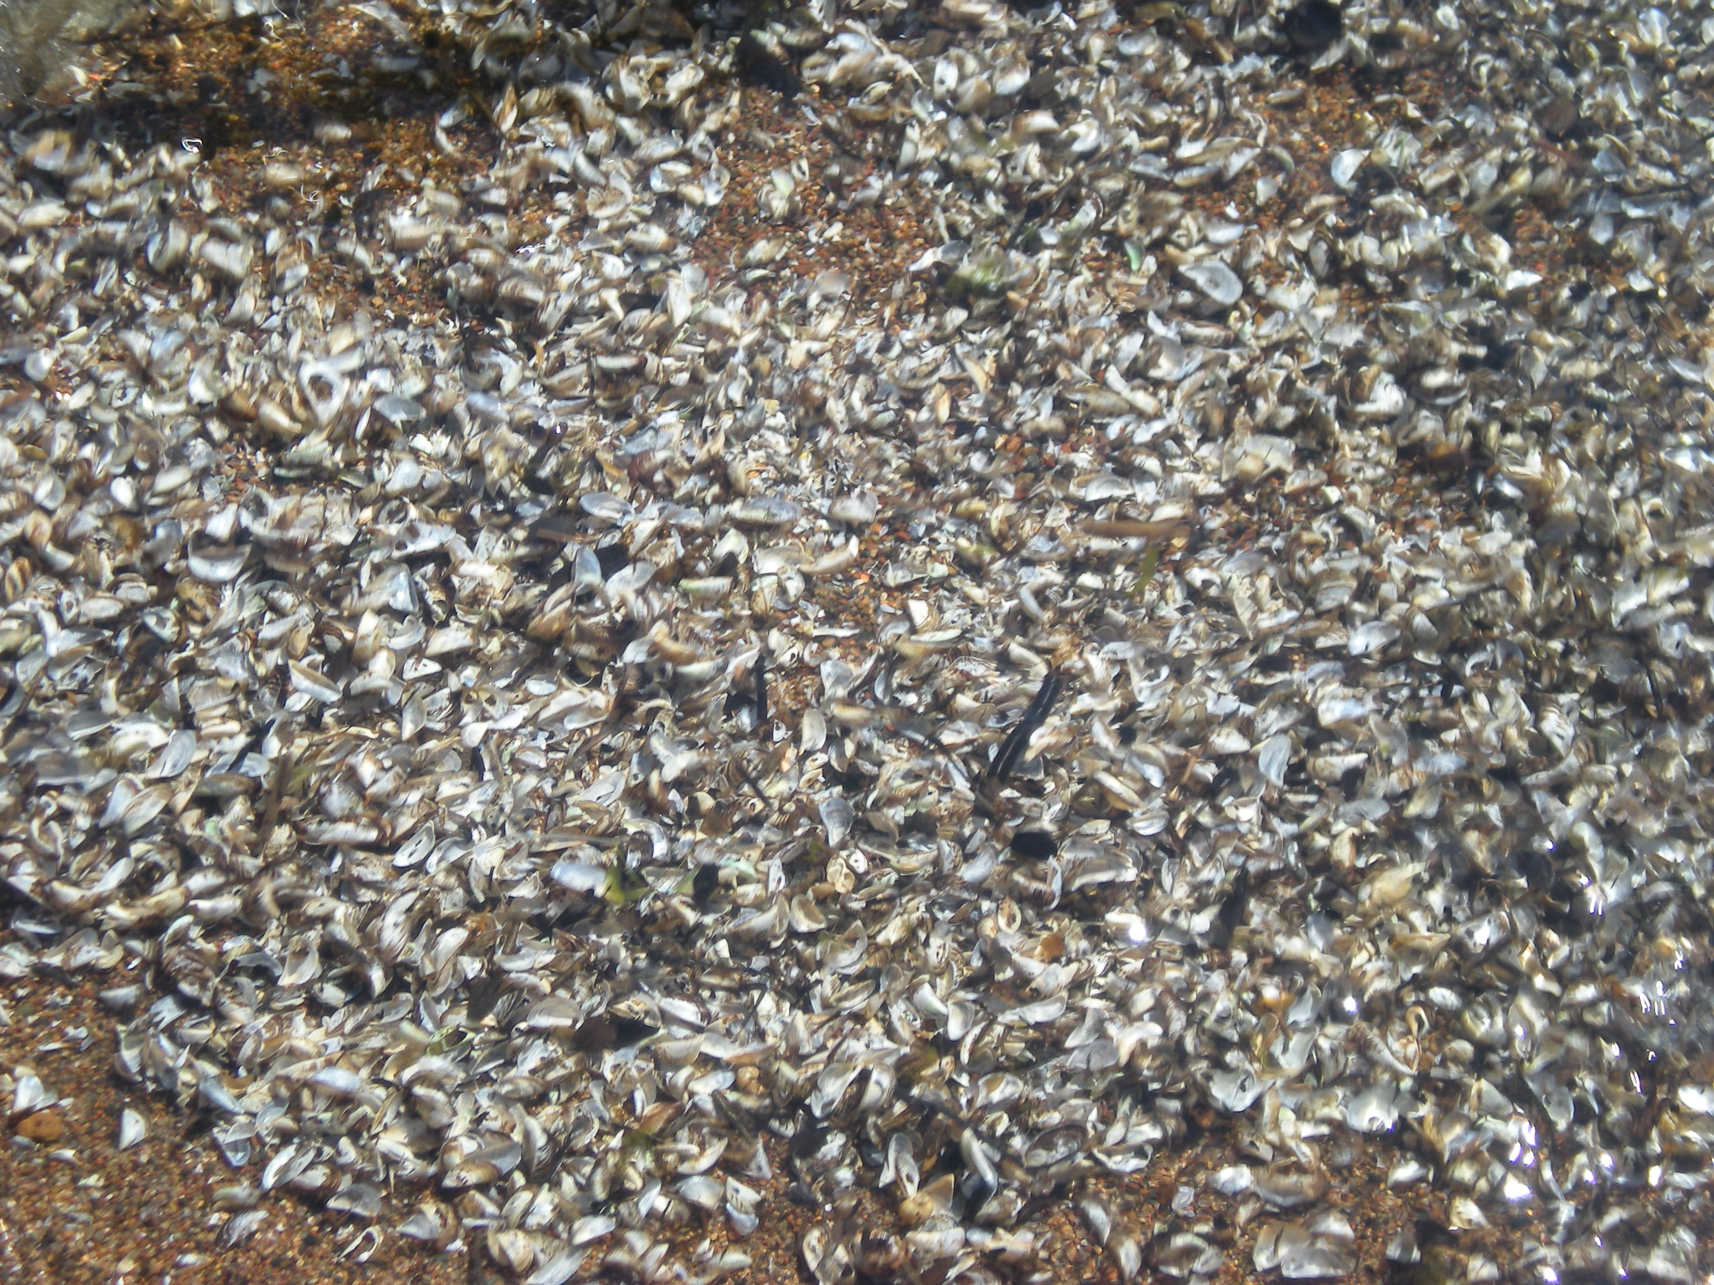
Watercraft Inspection Update
Jeff Bjorkman
Hubbard County AIS Taskforce

Slide 13
2013 Watercraft Inspection Overview
6658 Hours of Inspections
Over 10,000 Inspections Completed
21 Lakes Participated
9.5% of Boats from Infested Waters
12% Registered out of state
3% Had Vegetation attached
5% Had plugs in Boat at arrival
4% Had water in Boat at Arrival
10,000 Opportunities to Educate
1 in 10 Boats launched are a RISK to our Waters

Slide 14
Is our Program having an impact?
2012 MN DNR Roadside Checks 19% of boats had plugs installed
Hubbard County Results 5%
Non-Compliance Rate 74% Better than State Average
We are influencing Behavior and Compliance
CLEAN – DRAIN - DRY

Slide 15
2013 Financial Overview
Funding:
DNR $7750
City/Townships $35,990
County $35,000
Lake Associations $63,905
Total $142,645
Expenses:
Inspector/Staff Wages $97,468
Training $3092
SWCD Mgt. $35,000
Supplies $1302
Equipment (Decon, Computer) $5664
Total $142,526
45% Lake Associations – 25% County
25% City/Townships - 5% State DNR

Slide 16
Hubbard County Lake Access Inventory
57 Lakes with Public or Resort Access
67 Public Access Points
59 Resort Access Points ?
We Need your help to improve accuracy of information
SEE HANDOUT
E-mail corrections /additions to:
Jeff Bjorkman – jeffbjorkman1@gmail.com

Slide 17
2014 Program Objectives
1). Increase hours on HIGH Risk lakes with no or low hours
Low Hours No Hours
    Fish Hook Lower Crow Wings
    Belle Taine Middle Crow Wings
    Grace Lake George
    Kabekona 8th & 9th Crow Wing
    Plantagenet Bottle Lakes
    11th /10th Crow Wing Two Inlets
Can the Lake Associations find additional Funding?

Slide 18
2). Continue to Push Township/City Funding
CITIES: Park Rapids – Akeley – La Porte – Nevis
TOWNSHIPS:
Nevis – Crow Wing Lake – Clay – Farden – White Oak
Lake George - Two Inlets (Becker) – Frohn (Beltrami)
Arago – Lake Emma – Todd – Hubbard - Henrietta
Akeley – Lakeport – Rockwood – Thorpe – Helga
Mantrap
WE NEED YOUR HELP!
Lake Association efforts are key to Success

Slide 19
3). Add Car Counters to Select Sites
$2250 for SWCD Equipment
3 Counters and Software
$500 each to add additional counters
Lake Associations can opt. to purchase their own
Better Understand total Launch Utilization
Allows More Efficient use of $
Provide better Protection/Education

Slide 20
4). Increase Resort Participation
Funding
Inspections at Resort Launch
Educate Guests
Direct High Risk Boats to Decon
Possibly limit launch at resort?
We Need Consistent Level of Resort Engagement
Better Communication – Better Cooperation
We Need Lake Associations to take the lead in making this happen on their lake

Slide 21
5). Increase Utilization of Decontamination
Better Targeting of High Risk Boats
(Inboards, I/O’s, Wakeboard,Livewells)
Easier Access of Decon Stations
(Dedicated Level 2 Inspectors)
Provide Service at no Cost
Educate Everyone on simple Decon practices
Get High Risk Boats into Decon
From Infested Waters/Difficult to Drain

Slide 22
2014 Funding Strategies
-Get Lake Associations Involved in Township/City
Funding efforts
We Need Your Help!
Apply for Conservation Partnership Grants
Develop Formula for recommended Township Contributions
Monitor Potential for LOSHC Funding
Attempt to get LGU funding through State Legislature
Develop better local Fundraising strategies
Funding remains a local responsibility

Slide 23
One local Fundraising Example
Long Lake Area Association
Established a Foundation for Lake Association
Provides Tax Deductibility of donations
Sub Funds are available through COLA with NWMF
Annual effort launched in August for following years funding
Goal is to have funds available by Jan. 1st
Mail to all owners regardless of association membership
Include stamped return envelope
Increased response rate from 61 to 151
Recognize donors on website
Provide option to opt out
Encourage Family gifts at Holiday time
Use Newsletter and Website to update and remind membership of opportunity to do the RIGHT THING
Stress the Concept of passing on a Legacy
Average Response over $150

Slide 24
What we need from your Lake
Indicate your intent for inspections in 2014 to Nate at SWCD by 12-1-2013
Develop a funding plan for your hours and work with your township/City lake partners on funding requests
Develop a plan to raise Lake Association funding and execute that plan
Provide funds to SWCD by May 1st 2014 for the first 50% and July 1st 2014 for the balance
Let’s Work Together to make this Happen!
Need your Lake Association’s attendance on Nov. 6th !

